Slide 1




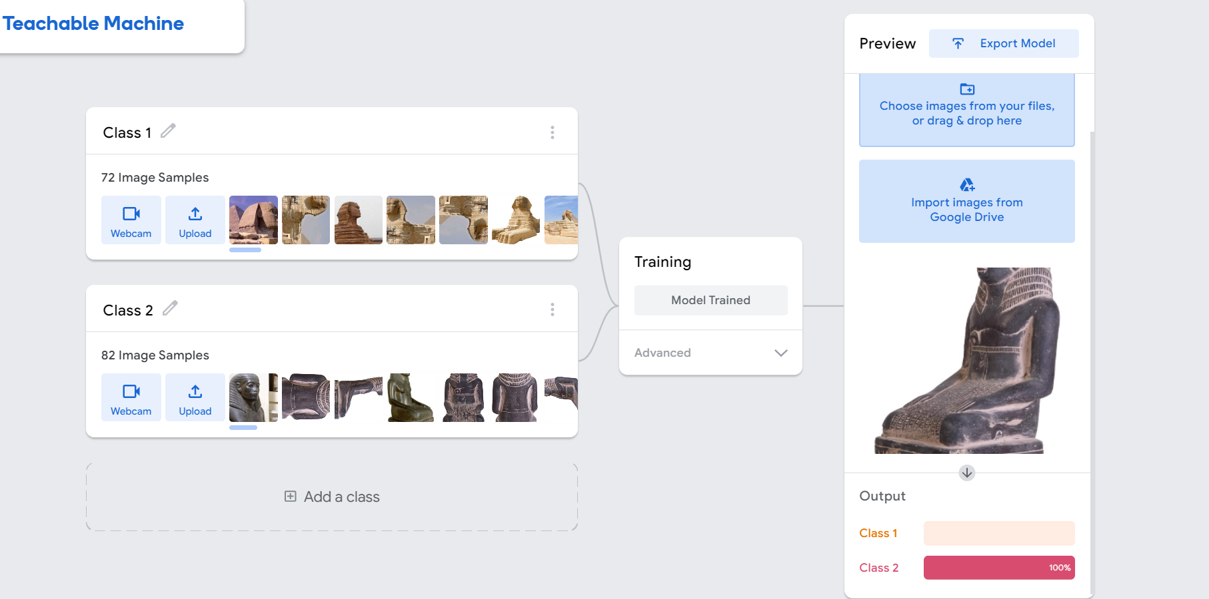
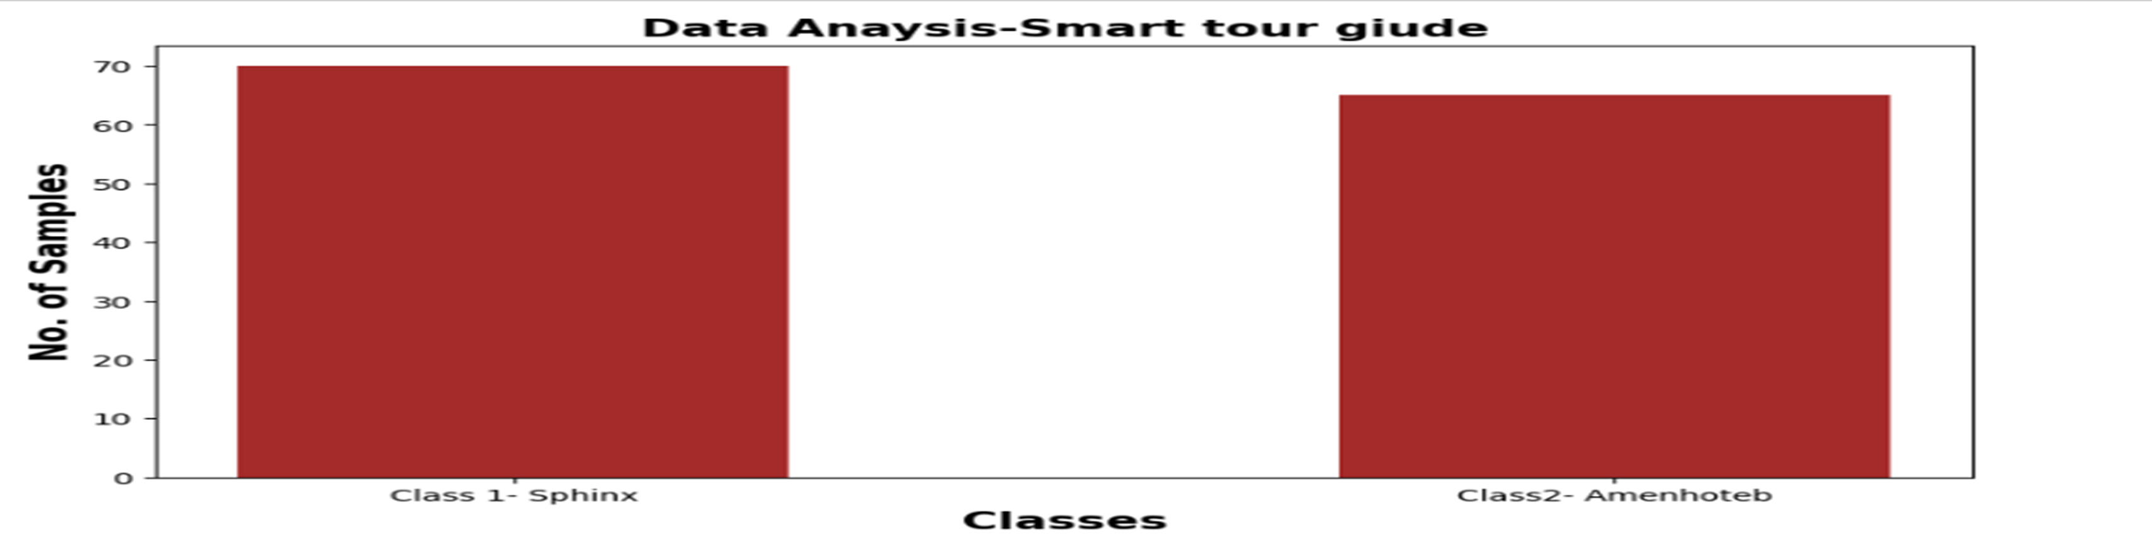







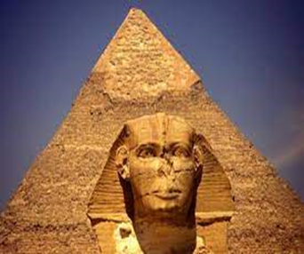


Smart Tour Guide
Group Number:J022202
Students Names: Abdelrahman Ahmed, Ziad Ayman, Mohamed Abdel Naser, Remonda Bassem, Salma Khaled
Abstract
Results and data analysis
Conclusions
The problem is that tourists do not know all of the historical places as monuments and statues, and they always need a tour guide so that he can give them the information they want to know, the number of tourist guides is few and the number of tourists is many. and also tourists spend time and effort. They have to go to every place with the tourist, and this takes them time and effort. Also, there are many trips that need a large number of guides.
we will put , pictures, and the information about the famous historical places in Egypt, and the tourist will be helped through this program. We put a voice, but we will put many features and modifications to this solution.
(1) We collected the data. which is about 2 classes, and each The first chapter consists of the Great Sphinx, containing 70 pictures, and the second, Amenhotep, contains 65 and monuments from all directions, and also a special label for each class, as well as the specifications of statues like age materials , symbol .
(2) Testing data set by using techeable machine
The problem is that tourists do not know the history of monuments and statues, and they always need a tour guide so that he can give them the information they want to know,
The solution is an application in which the user takes pictures of the statue from any side of it, and the application output will be some information about the real statue
We take photograph the statue, each statue 40 pictures from all its aspects, the app will supply us with the needed information.
Introduction
Business Model Canvas
Recommendation
We deal with Decent work and economic development( SDGs). Tourism is one of the largest economic activities in Egypt. There are people who do not know the tourist places and they always need guides. We will create an application through tourists who will know information about monuments and places _The good points are that the application helps tourists. They know information about the monuments and historical places that exist in the history of Egypt.
Key Partners 1-ministry of tourism . 2-Data will be collected from all Egyptian historical places, tourism development authority , Egyptian museum. | Key Activities data collection. Application development.t (Google) about great sphinx and Amenhotep. meeting With tourism companies . | Value Proposition 1: The name of the project is the smart tour guide. 2: The idea is new. 3:The problem is that the tourists do not know information about the historical places in Egypt, and they need guides to give them information about the tourist statues and determine two classes as a first prototype. :4 our goal is to increase the number of tourists coming . | Customer Relationship Relationship customer service , give unique services ( free for two month after that by money) monthly upgrade, Video to help learn how to use the app. | Customer Segments hybrid 1-(b2c) As tourists. 2- (b2b) Tourist companies.
 | Key Resources Hardware : 1-pc For programing 2- camera (image about status) 3- data information’s Software : Jupiter |  | Channels 1- adverts . 2- social media . 3- visiting tourist companies.
Cost Structure fixed 1) Developer salaries. 2) Marketing . 3) Ads. Non fixed Hardware materials . |  |  | Revenue Streams 1- By adding the ads in our application. 2- Sells the app to companies .
We have collected data from archaeological sites such as the sphinx and Amenhotep
In the future, we will collect information about the customs and traditions of the ancient Egyptians, religion, and wars.
References
1) Amenhotep (
Ahmed, T. (2022). Hurghada Excursions Lovers | Best Egypt Tours / Travel Agency. https://hurghadalovers.com/ar/king-amenhotep-iii-egyptian-pharaohs-kings/
2) sphinx SuperCairo, SuperCairo, & SuperCairo. (2018).https://supercairo.com/wallpapers-photos-of-sphinx/
Methods and Materials
Materials: Hardware :
1-pc
2- camera (image about status)
3- text
Give user some information about statues
Methods :
Picture and data about most famous tourist sites all over Egypt will be collected data and fed into app . To help tourist .
Acknowledgement
We are thankful these people: Ms. Rasha Saleh, Mr. Abdelrahman , Mr. Mohamed adlay and Mr. Kareem Atif .

